Slide 1
Describing and Interpreting Tables and Figures
Modibo SANGARE, M.D., Ph.D., Associate Professor
University of Sciences, Techniques and technologies of Bamako (USTTB)
July 4th-6th, 2023
AFREhealth manuscript writing
English Course 2

Slide 2

Take a guess

Slide 3

Rationale

Slide 4
Describing and Interpreting a Table
1. Read the title, which is always before the table itself.
2. Read through the first row (at the top) and the first column (on the left)
3. Scan the content for trends (increasing, decreasing, the highest or the lowest, no change).
  You pay a close attention to frequency and percentage
  You compare (using comparative and superlative of adjectives)
4. Don't use your own general knowledge either to explain or to add more information to the data.

Slide 5
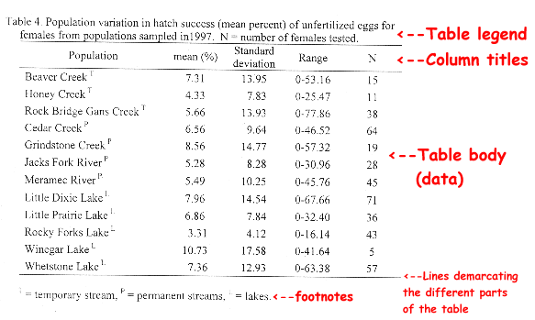
Anatomy of a Table

Slide 7
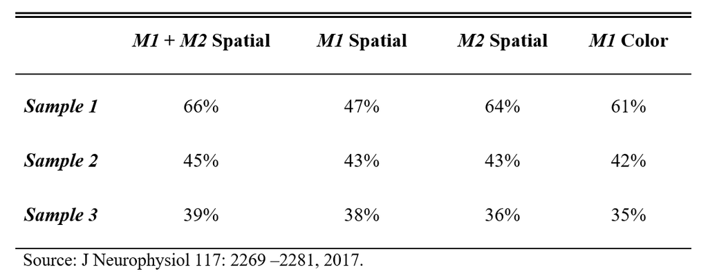
What do you think of this table?

Slide 8
Describing and Interpreting a Figure
Read the title, which is usually below (after the figure).
Look at the headings and units used
Read the labels (on X axis and Y axis).
Then study the figure to understand what it shows. - pay a close attention to the peak (s)
- pay a close attention to the curves (dose-reponse)
https://sciencing.com/proper-way-label-graph-5195234.html

Slide 9
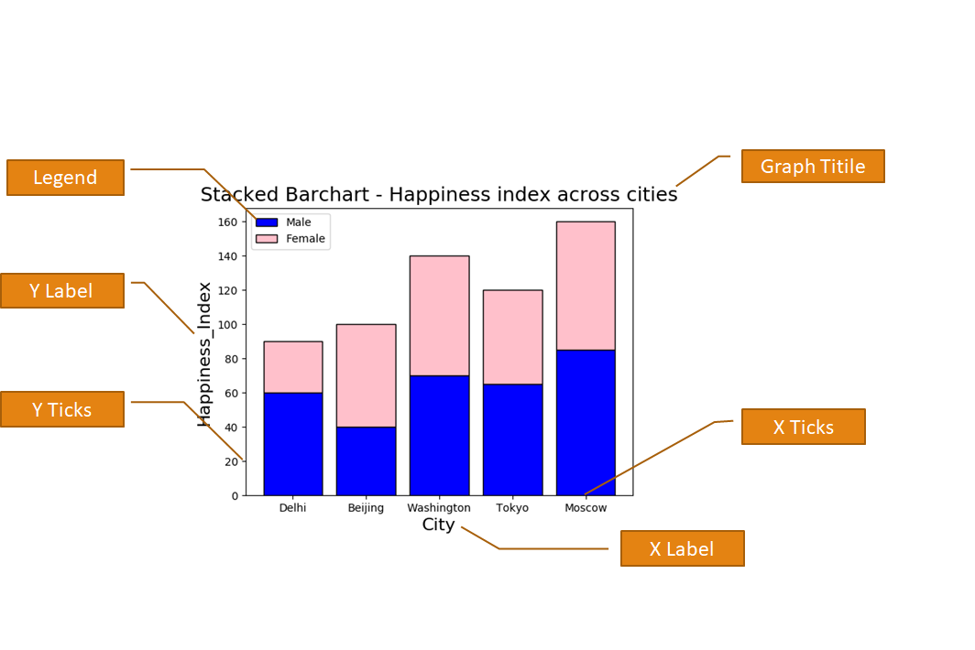
Anatomy of a Figure

Slide 10
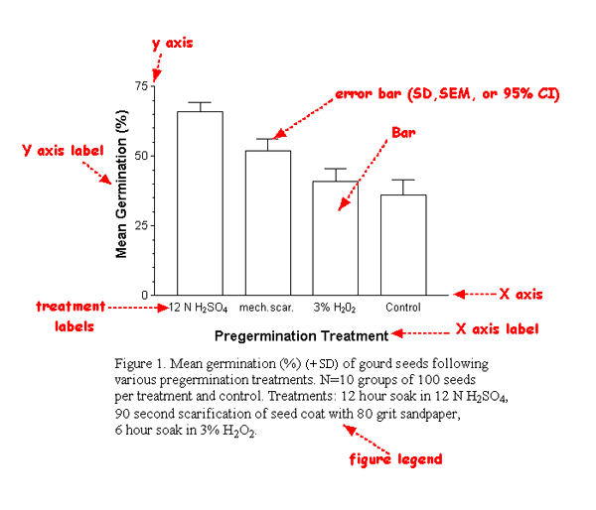
Figure

Slide 11
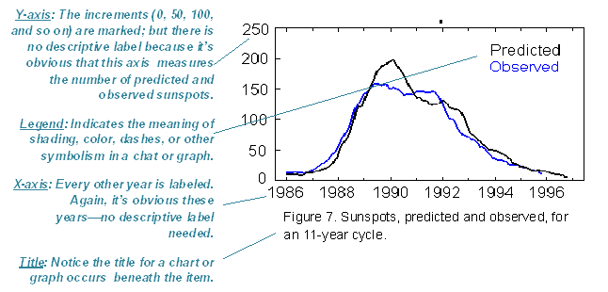
Figure

Slide 12
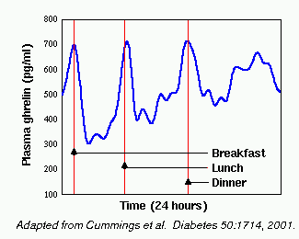
A question for a champion: What is this figure about?

Slide 13
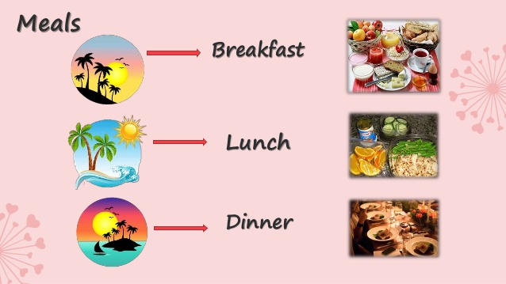
This is universal. We eat three meals a day.
7 AM
12 PM
5 PM
Note: Late Evening Snack (L.E.S) is at 9 PM.

Slide 14
A graph
Read the title, which is usually placed in the center, either above or below the graph.
2. Look at the keys,
  Typically in a box next to the graph.
  To explain symbols and colors used in the graph.
3. Read the labels.
4. Then study the graph to understand what it shows.
https://sciencing.com/proper-way-label-graph-5195234.html

Slide 15
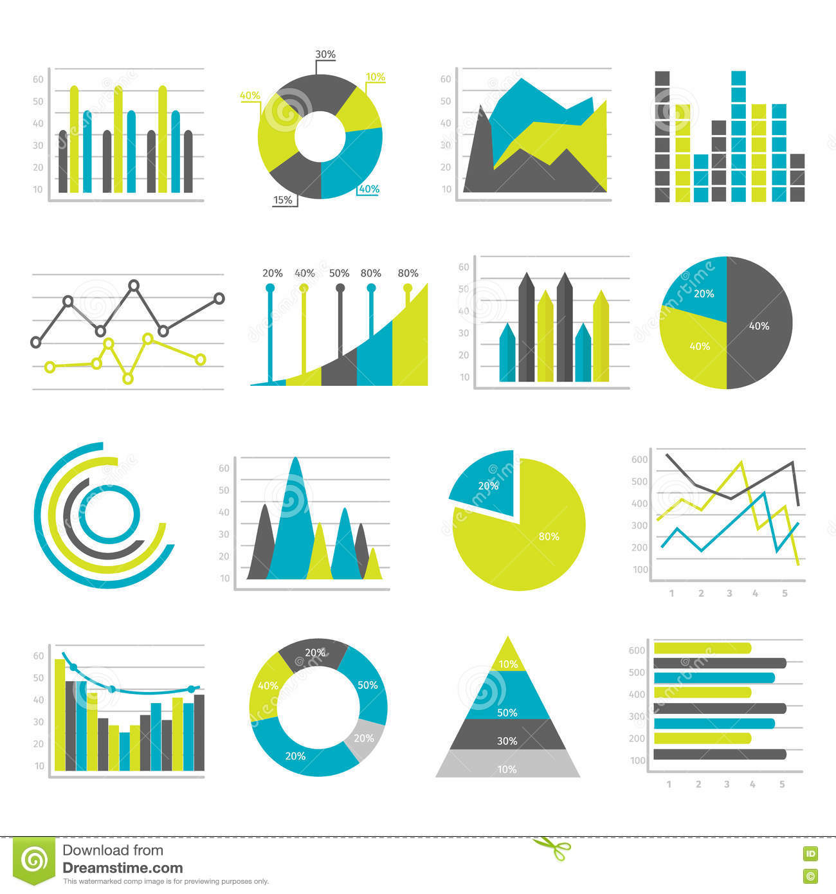
Different forms for the same purpose: present data

Slide 16
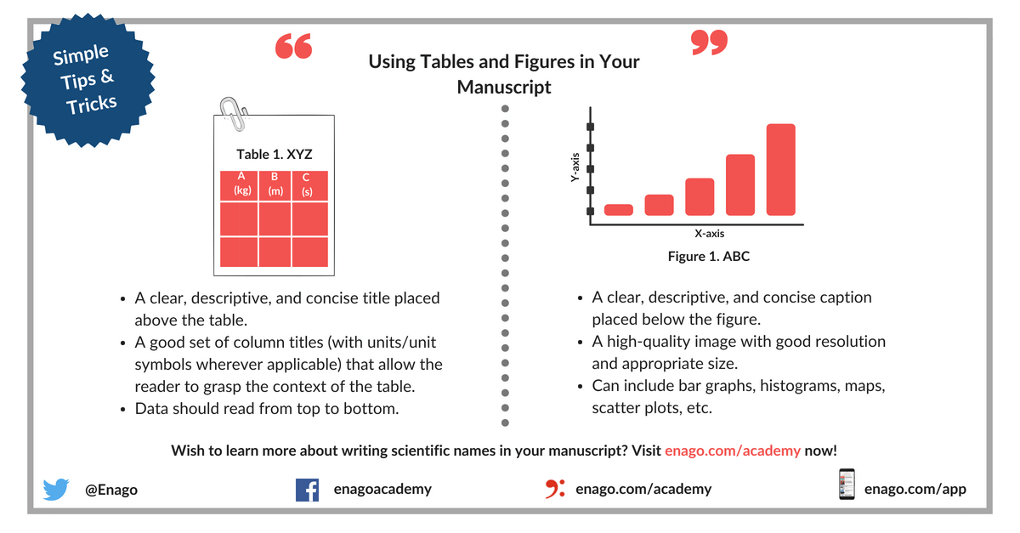
In Sum
Tables (to present raw data) versus Figures (to show relationship)

Slide 17


Slide 18
Thank You

