Slide 1
Original Research Article: IMRaD Structure
Modibo SANGARE, MD, PhD
Associate Professor at the USTTB
Bamako, Mali
English Course 2
July 10-13, 2023

Slide 2
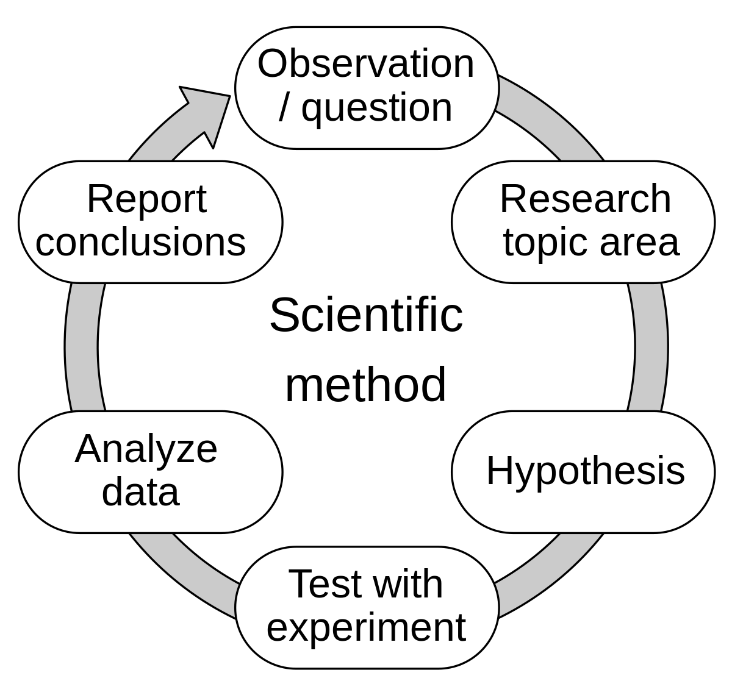
Research Methodology
https://upload.wikimedia.org/wikipedia/commons/thumb/8/82/The_Scientific_Method.svg/1200px-The_Scientific_Method.svg.png

Slide 3
Research Methodology
https://i.ytimg.com/vi/jrw6NRp2snc/maxresdefault.jpg

Slide 4
https://cdn.educba.com/academy/wp-content/uploads/2021/01/Types-of-Research-Methodology.jpg

Slide 5
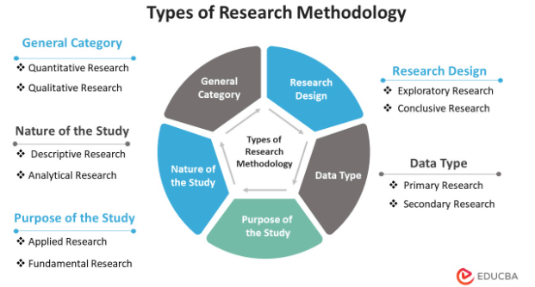
https://cdn.educba.com/academy/wp-content/uploads/2021/01/List-of-Research-Methodlogy.png

Slide 6
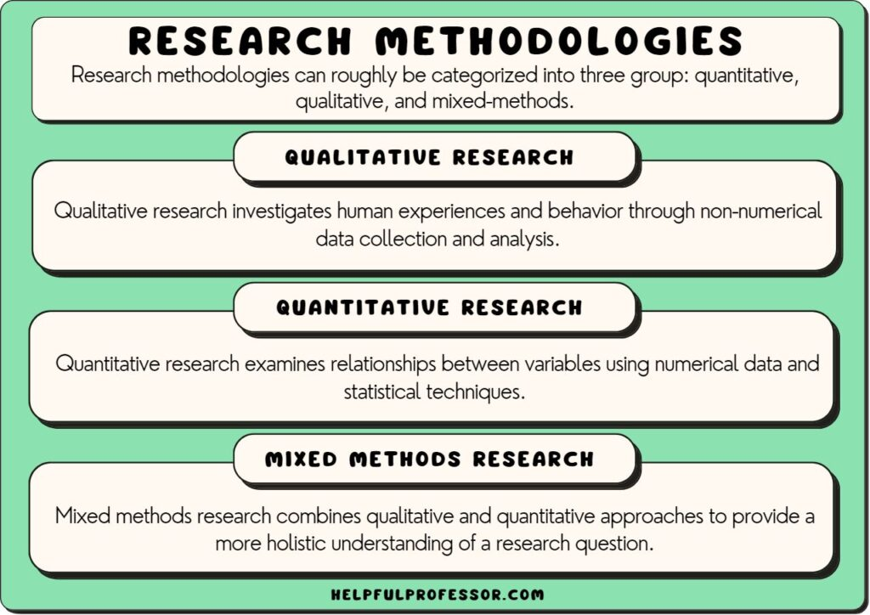
https://helpfulprofessor.com/wp-content/uploads/2023/05/research-methodologies-1024x724.jpg

Slide 7
Qualitative Research Methods
https://www.questionpro.com/blog/wp-content/uploads/2018/03/82-Qualitative-Research-Methods.jpg

Slide 8
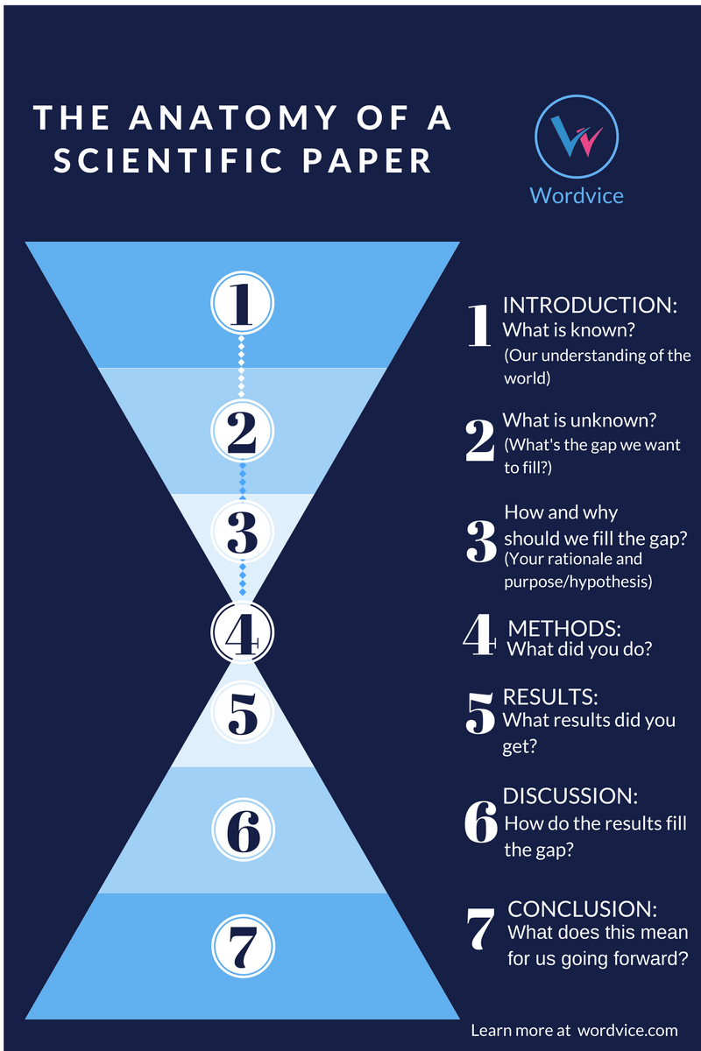
IMRaD Format 1/2
https://blog.wordvice.com/how-to-draft-a-compelling-introduction-for-your-journal-article/

Slide 9
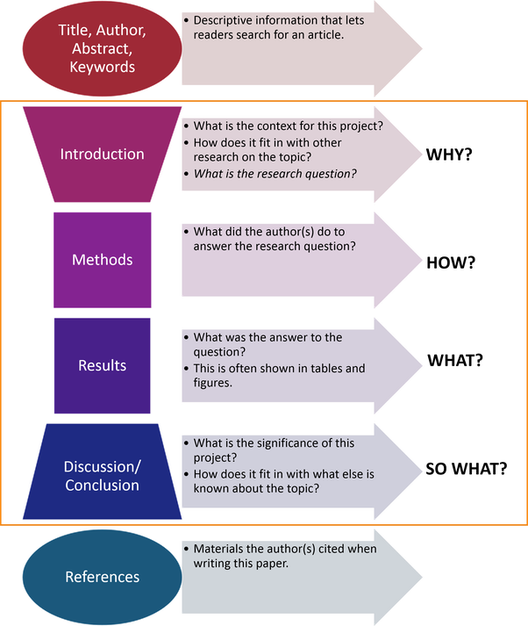
IMRaD Format 1/2
https://peachyessay.com/wp-content/uploads/2020/11/Research-Paper-Structure.png

Slide 10
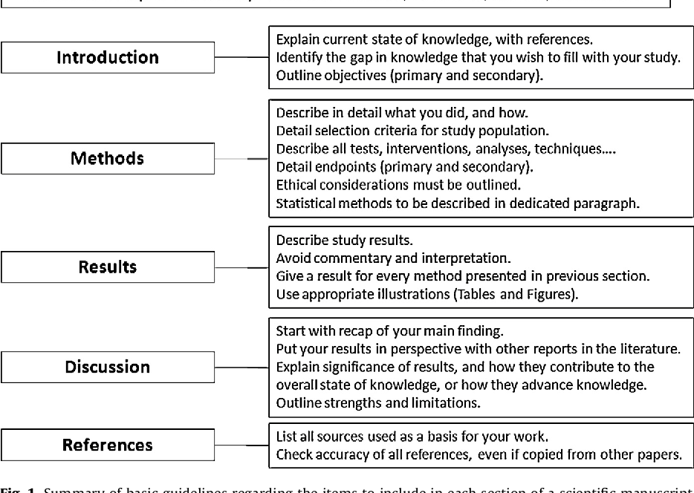
IMRaD Format 2/2
https://d3i71xaburhd42.cloudfront.net/b5614bf9e6cf02904802dfa5bc0ad23e58108bff/6-Figure1-1.png

Slide 11
Introduction Section
https://www.gofastresearch.com/2020/05/introduction-for-a-research-paper.html

Slide 12
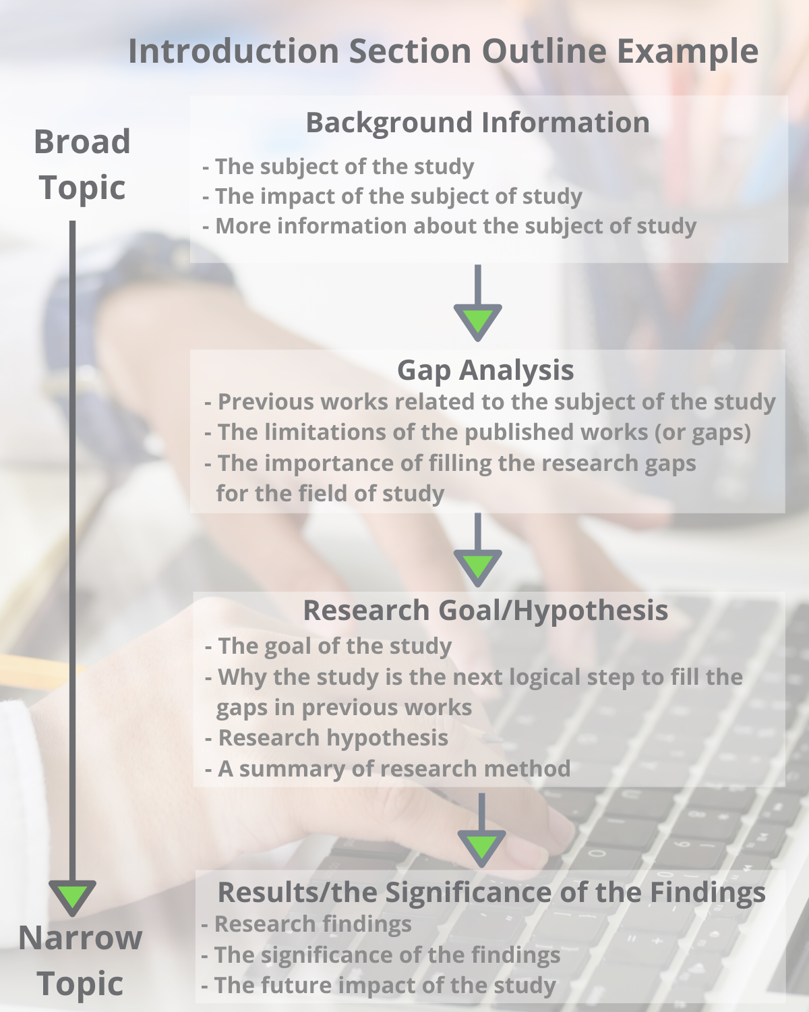
Introduction Section
https://goldbio.com/articles/article/how-to-write-introduction-section

Slide 13
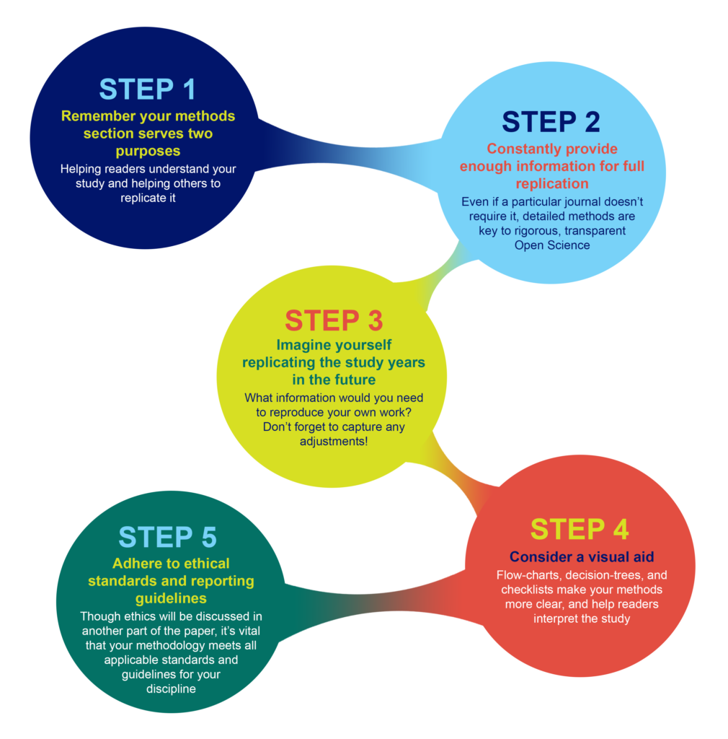
Material and Methods Section
https://plos.org/wp-content/uploads/2020/10/Methods-infographic_3-1010x1024.png

Slide 14
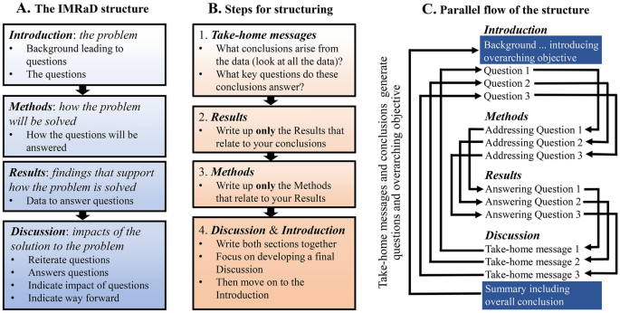
Montagnes, D.J.S., Montagnes, E.I. & Yang, Z. Finding your scientific story by writing backwards. Mar Life Sci Technol 4, 1–9 (2022). https://doi.org/10.1007/s42995-021-00120-z

Slide 15
https://images.ctfassets.net/dkgr2j75jrom/6EkS63alrQ62cHmOClGQnZ/b96701f832d50d393f859d73225c2b57/PillarPage-Qual-Quan__1_-min.png?w=2500&h=1276&q=50&fm=png

Slide 16
https://plantlet.org/wp-content/uploads/2020/03/11.jpg

Slide 17
https://images.slideplayer.com/26/8386925/slides/slide_4.jpg

Slide 18
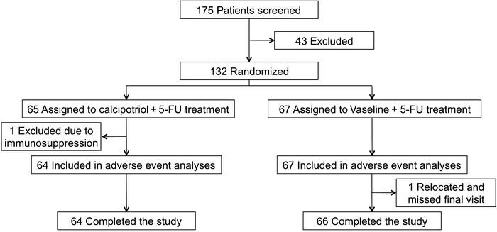
Flow chart
https://dm5migu4zj3pb.cloudfront.net/manuscripts/89000/89820/medium/JCI89820.f2.jpg

Slide 19
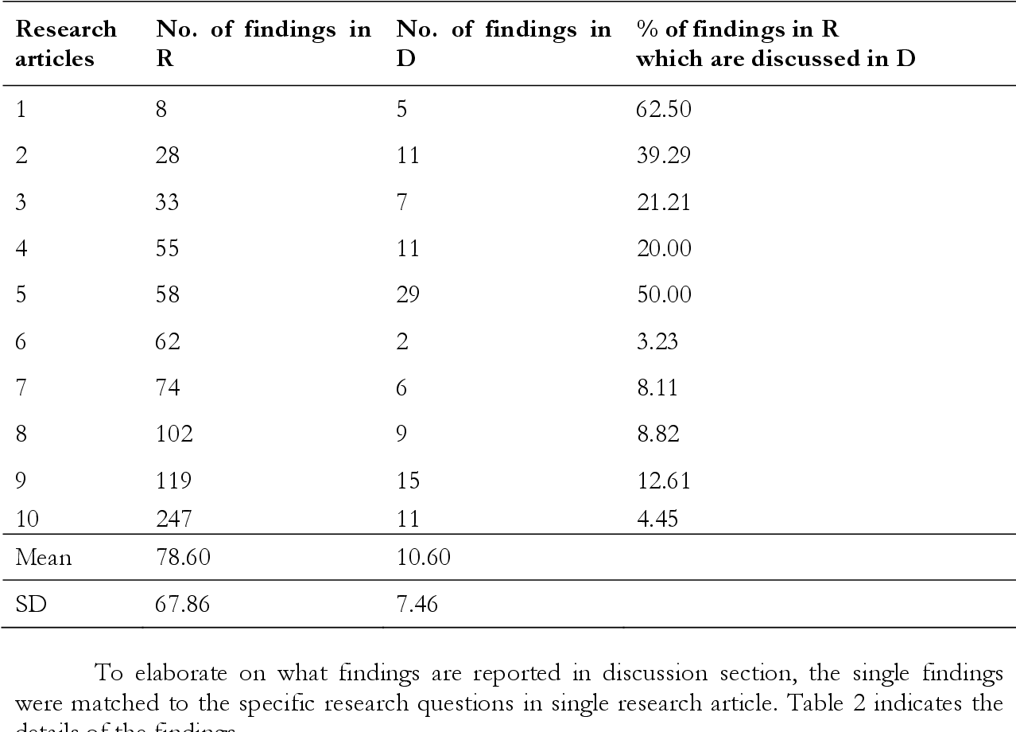
https://d3i71xaburhd42.cloudfront.net/3fd965e879e3669a1a22f2306341941189b14355/5-Table1-1.png

Slide 20
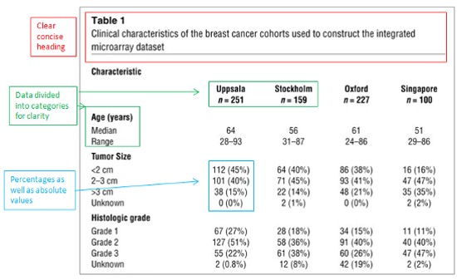
https://learning.edanz.com/wp-content/uploads/2019/11/Table-1.jpg

Slide 21
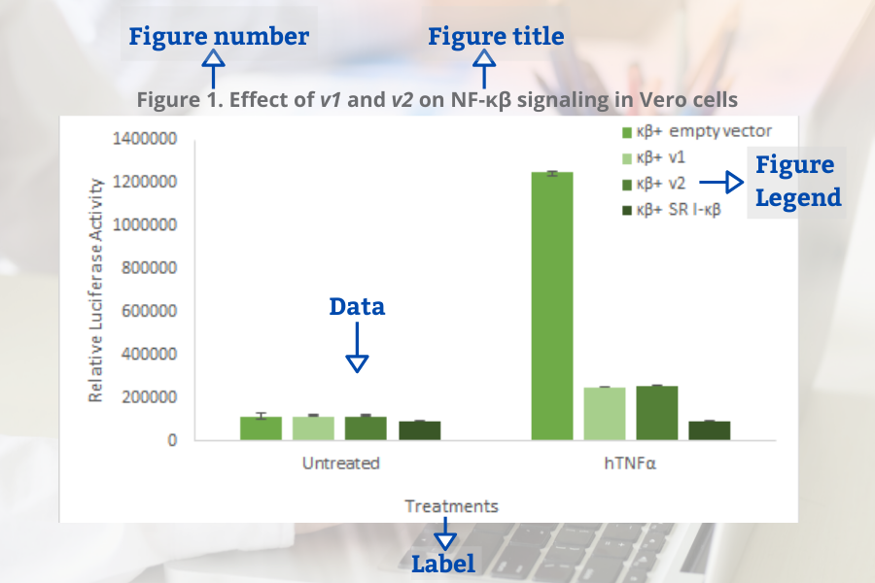
https://commercio.nyc3.digitaloceanspaces.com/goldbio-2018/pages/Figure%20Example.png

Slide 22
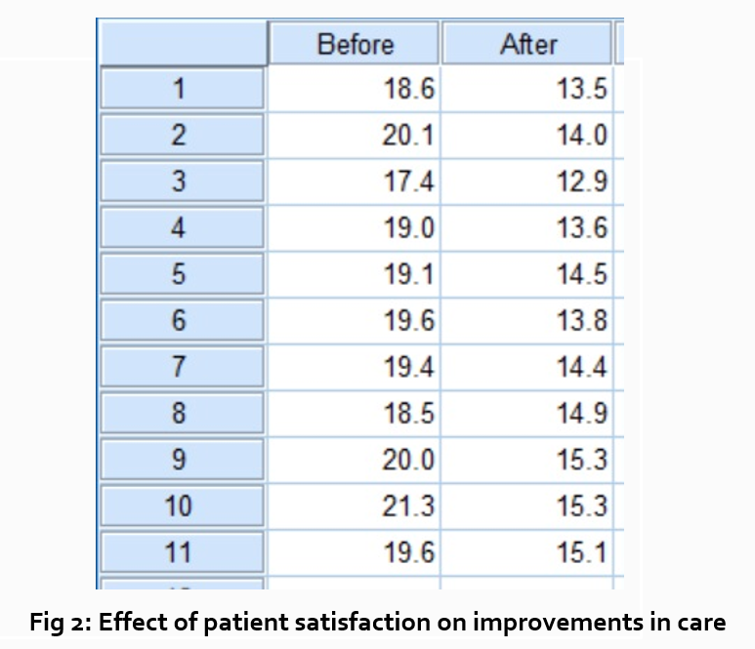
What do you think?
https://wordvice-blog-production.s3.ap-northeast-1.amazonaws.com/us/wp-content/uploads/2021/08/11051811/T-table.png

Slide 23
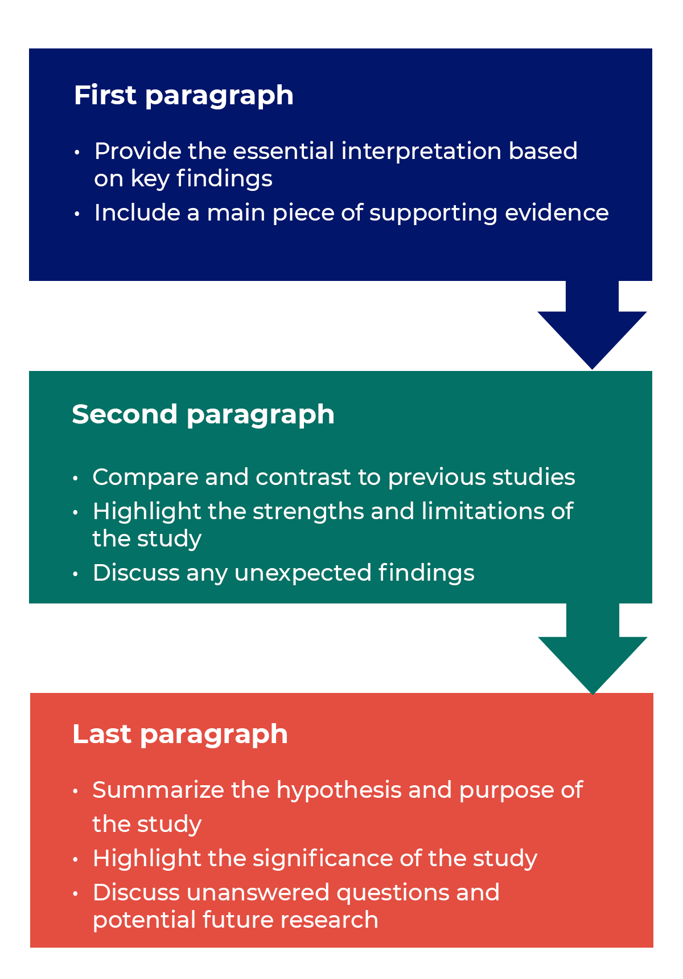
Discussion Section 1/4

Slide 24
Discussion Section 2/4
Step 1: Summarize your key findings.
Step 2: Give your interpretations.
Step 3: Discuss the implications.
Step 4: Acknowledge the limitations.
Step 5: Share your recommendations.
https://www.google.com/search?client=firefox-b-d&q=how+to+write+a+discussion+in+a+research+paper#ip=1

Slide 25
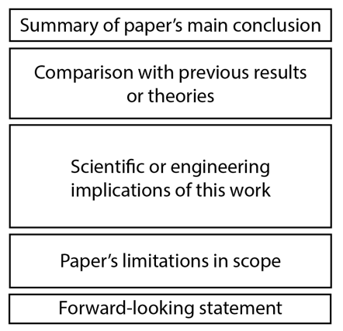
Discussion Section 3/4
https://mitcommlab.mit.edu/broad/commkit/journal-article-discussion/

Slide 26
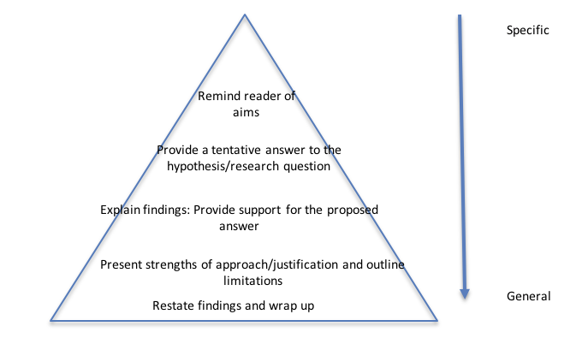
Discussion Section 3/4
https://studyskills.federation.edu.au/wp-content/uploads/2021/11/discussion.png

Slide 27
Implications in the Discussion Section
The result 1: One study found that learning items over time improves memory more than cramming material in a bunch of information at once.
The implication 1: This result suggests memory is better when studying is spread out over time, which could be due to memory consolidation processes.
The result 2: An intervention study found that mindfulness helps improve mental health if you have anxiety.
The implication 2: This result has implications for the role of executive functions on anxiety.
The result 3: A study found that musical learning helps language learning in children.
The implication 3: These findings suggest that language and music may work together to aid development.
https://www.aje.com/arc/implications-or-recommendations-in-research/

Slide 28
Implications in the Discussion Section
A meta-analysis found that actively recalling material from your memory is better than simply re-reading it.
The recommendation: Based on these findings, teachers and other educators should encourage students to practice active recall strategies.
A medical intervention found that daily exercise helps prevent cardiovascular disease.
The recommendation: Based on these results, physicians are recommended to encourage patients to exercise and walk regularly. Also recommended is to encourage more walking through public health offices in communities.
A study found that many research articles do not contain the sample sizes needed to statistically confirm their findings.
The recommendation: To improve the current state of the field, researchers should consider doing power analysis based on their experiment's design.
https://www.aje.com/arc/implications-or-recommendations-in-research/

Slide 29
https://images.slideplayer.com/39/11069299/slides/slide_3.jpg

Slide 30
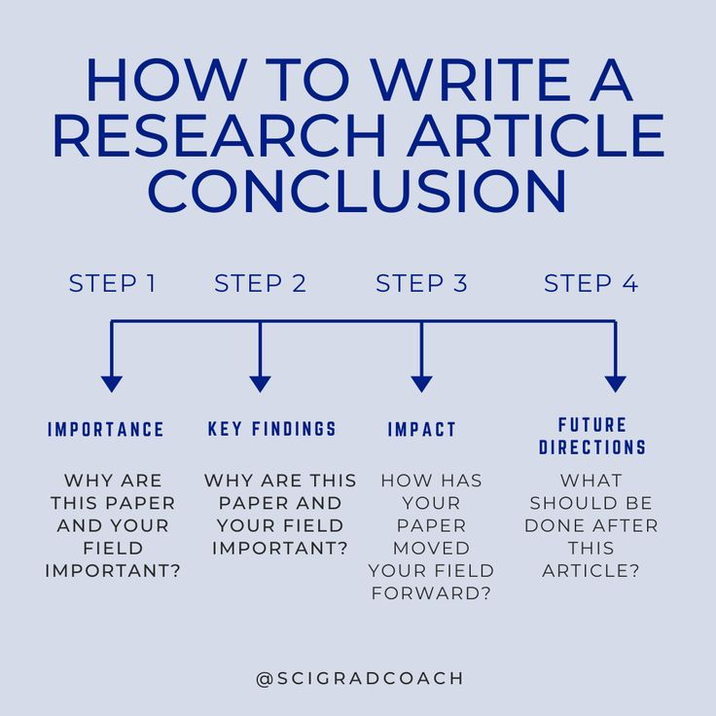
https://i.pinimg.com/originals/55/07/54/55075466c55ea59263948dfac92d8ea5.jpg

Slide 31
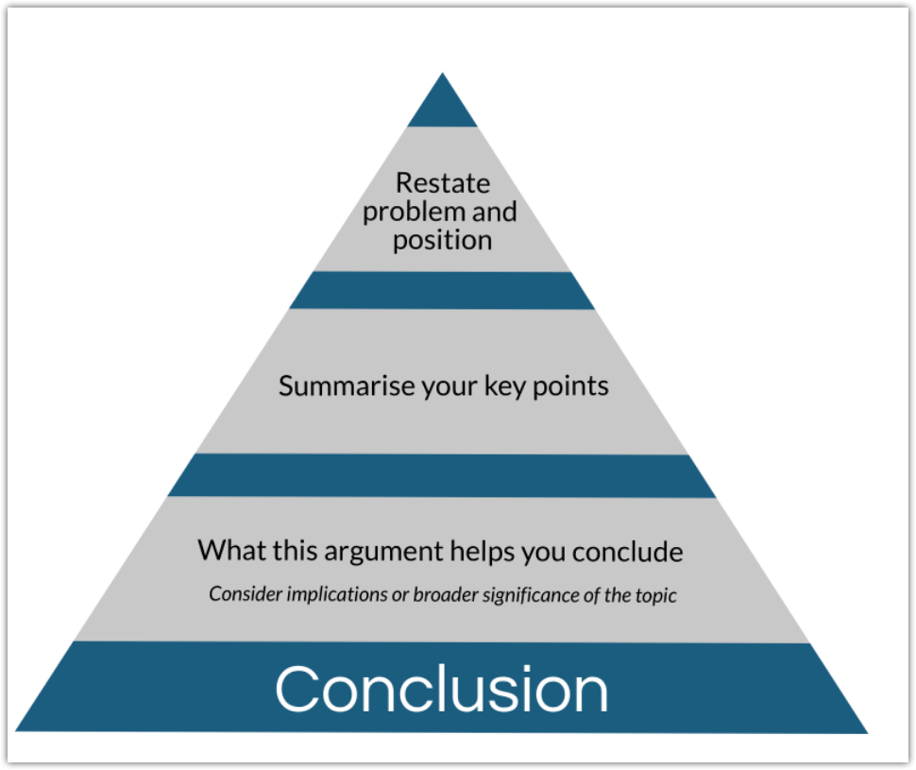
https://blog.externetworks.com/staging/wp-includes/images/2020-6/format-of-research-paper.png

Slide 32
https://www.aje.com/arc/implications-or-recommendations-in-research/

Slide 33
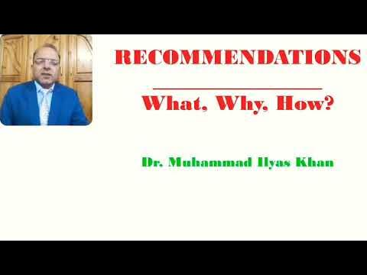
https://i.ytimg.com/vi/p4AbcC1rGuk/hqdefault.jpg?sqp=-oaymwEmCOADEOgC8quKqQMa8AEB-AHUBoAC4AOKAgwIABABGBMgSCh_MA8=&rs=AOn4CLB-lFVde-Snq-bSW9rIij6YRGUMaw

Slide 35
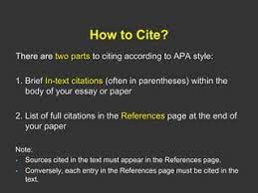
https://image.slidesharecdn.com/citationandreferencinginresearchwork-150127125255-conversion-gate01/85/citation-and-referencing-in-research-work-24-320.jpg?cb=1665786742

Slide 36
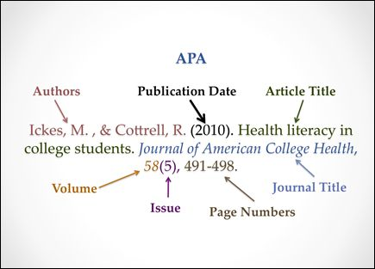
https://i.pinimg.com/474x/2e/70/a9/2e70a9391950ed682b9a9a5353fbfa3d--apa-essay-format-apa-format-paper.jpg

Slide 37
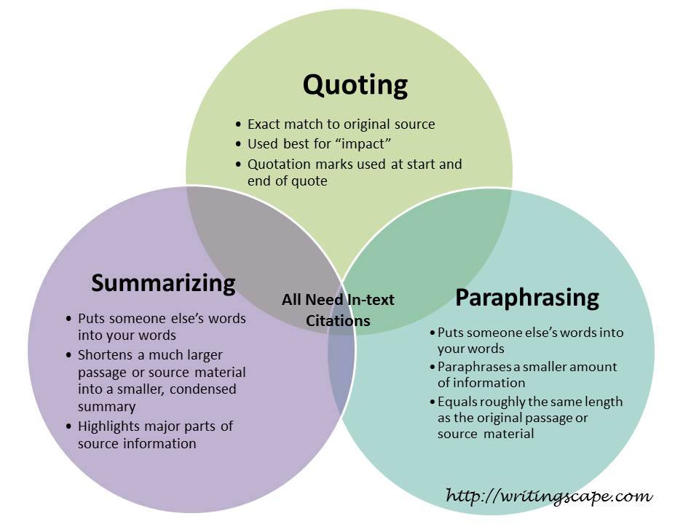

Slide 38
https://pressbooks.nscc.ca/app/uploads/sites/155/2021/05/summary-steps.jpg

Slide 39
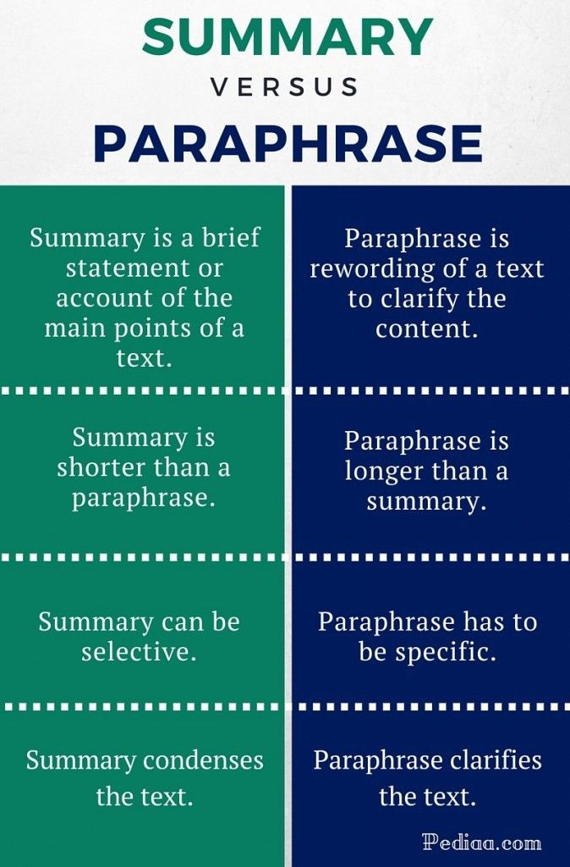
https://quillbot.com/blog/content/images/2021/12/0_7ciJRprBMo1UWBw3.jpg

