Slide 1
SQ3R method of reading
Modibo SANGARE, M.D., Ph.D., Associate professor
University of Sciences, Techniques and technologies of Bamako (USTTB)
July 4th-6th, 2023
AFREHealth manuscript writing
English Course 2

Slide 2
Rationale
https://images.app.goo.gl/hSwG6fBo365dvdQZ6

Slide 3
Useful reminder
Writing is conventional.
one chapter equals one topic.
one paragraph develops one main idea.
The main idea: first and last sentences in a paragraph.
one sentence conveys one complete thought.
Text and figures/tables/photos/graphs are complementary.
figures/tables/photos/graphs should be comprehensible w/o the text.
Important information are highlighted (bold, italic or underline).
Side notes, abstract and resume are important.

Slide 4
https://images.app.goo.gl/7xCMvox3xi9cX5Tv9

Slide 5
What is the SQ3R method?
SQ3R is a reading strategy formed from its letters:
Survey!
Question!
Read!
Recite!
Review!
Note: SQW3R when read and write.
Author: Francis Robinson in his 1941 book entitled, “Effective Study.”

Slide 6
Survey!
Before you read, Survey the article:
Read the title
Look at the author list;
Read the abstract;
Understand the tables, figures, graphs without reading the text;
- describe and interpret
Read the introductory and concluding paragraphs;
- first paragraph of the introduction and last paragraph of the discussion
Read the first and last sentences of each remaining paragraph;
Read underlined, bolded and italicized passages and sidenotes.

Slide 7
Question!
Question while you are surveying:
Turn the title, headings, and/or subheadings into questions;
Write questions you may have asked during the survey;
Note: If it is helpful to you, write down all these questions. This variation is called SQW3R.

Slide 8
Read!
When you begin to Read:
Look for answers to the questions you have noted
Reread captions under pictures, graphs, etc.
Note all the underlined, italicized, bold printed words or phrases
Reduce your speed for difficult passages
Stop and reread parts which are not clear
Read only a section at a time

Slide 9
Recite!
Recite after you've read a section:
Orally ask yourself questions about what you have just read,
Summarize in your own words what you have just read,
Take notes from the text in your own words
if copy and paste, make sure to paraphrase and check for plaigiarism
Underline or highlight important points you've just read
Note: The more senses you use the better your memory
Triple strength learning: Seeing, saying, hearing
Quadruple strength learning: Seeing, saying, hearing, writing!!!

Slide 10
Review!
Review is an ongoing process.
Remember:
Short term memory: attention and quietness
Long term memory: repetition and good sleep
Repetition means Learn-Relearn-Revise.
Good sleep: 6 hours in a dark and quiet place at night
It says, “Knowledge is what you remember after you forget everything.” Long term memory.

Slide 11
https://images.app.goo.gl/rB9wqK2z9wFeBs8N9

Slide 12
THANK YOU

Slide 13
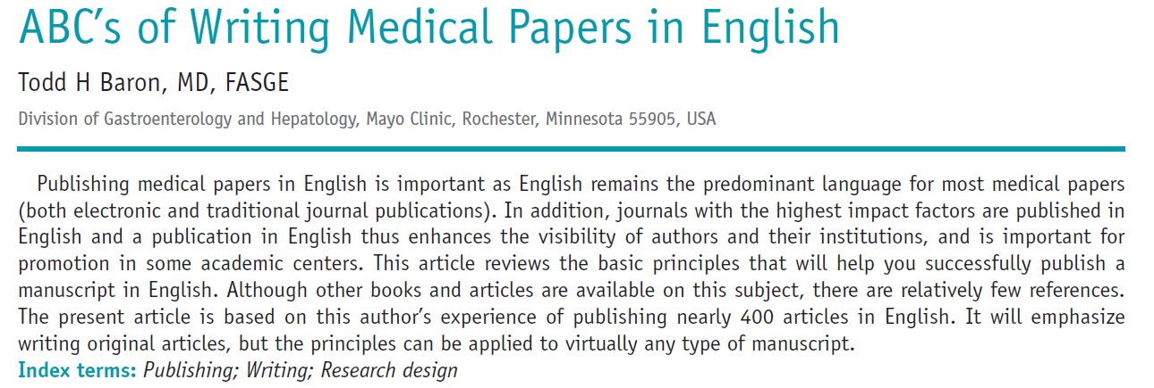

Slide 14
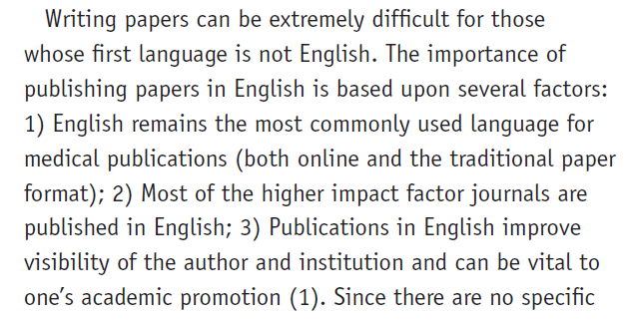
First paragraph

Slide 15
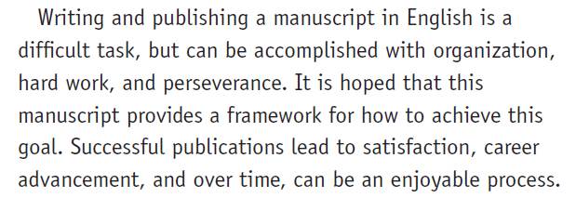
Last paragraph

Slide 16
First and last sentences 1/10

Slide 17
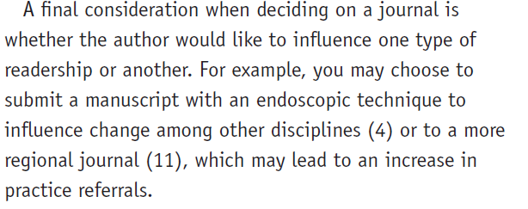
First and last sentences 2/10

Slide 18
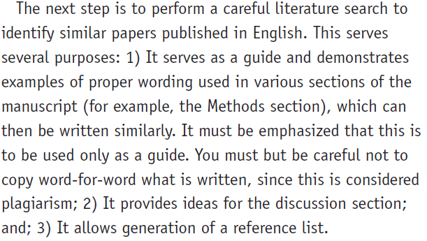
First and last sentences 3/10

Slide 19
First and last sentences 4/10

Slide 20
First and last sentences 5/10

Slide 21
First and last sentences 6/10

Slide 22
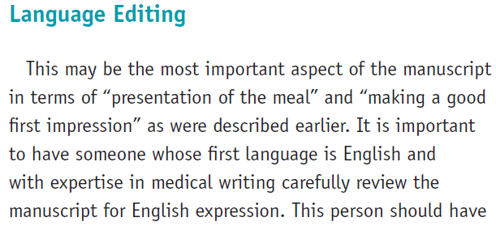
First and last sentences 7/10

Slide 23
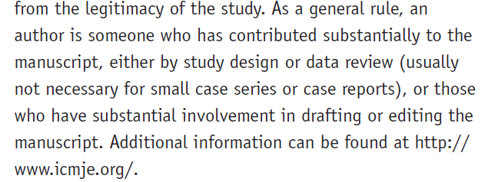
First and last sentences 8/10

Slide 24
First and last sentences 8/10

Slide 25
First and last sentences 9/10

Slide 26
First and last sentences 10/10
Notes:
No fabrication, No falsification, No Plagiarism

Slide 28
