Slide 1
Today session
Modibo SANGARE, MD, PhD
August 19,2023

Slide 2
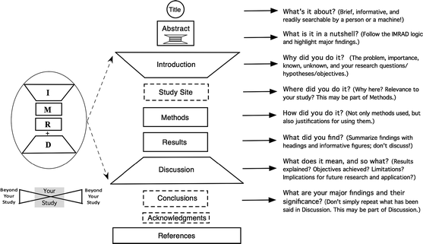
https://media.springernature.com/lw685/springer-static/image/art%3A10.1007%2Fs10980-011-9674-3/MediaObjects/10980_2011_9674_Fig1_HTML.gif

Slide 3
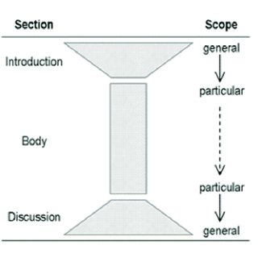
Hourglass Model
https://www.researchgate.net/publication/352759651/figure/fig1/AS:1038815242240003@1624684262421/The-Hourglass-Model-light-grey-parts_Q320.jpg

Slide 4
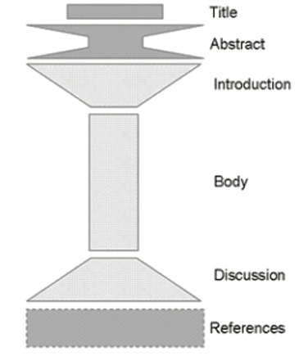
The King Model
https://d3i71xaburhd42.cloudfront.net/f1410bfa326762c77647cf8a4fa47110886948e5/2-Figure1-1.png

Slide 5
https://pbs.twimg.com/media/C1N5cHaXgAA7Co_.jpg

Slide 6
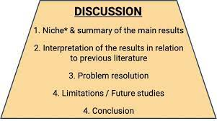
https://abrilliantmind.blog/wp-content/uploads/2020/10/Shape-1024x571.jpg

Slide 7
Thank you

