Slide 1
Initiation to Journal Club
Modibo SANGARE, MD, PhD
Manuscript Writing Workshop
Bamako, Mali
August 17, 2023

Slide 2
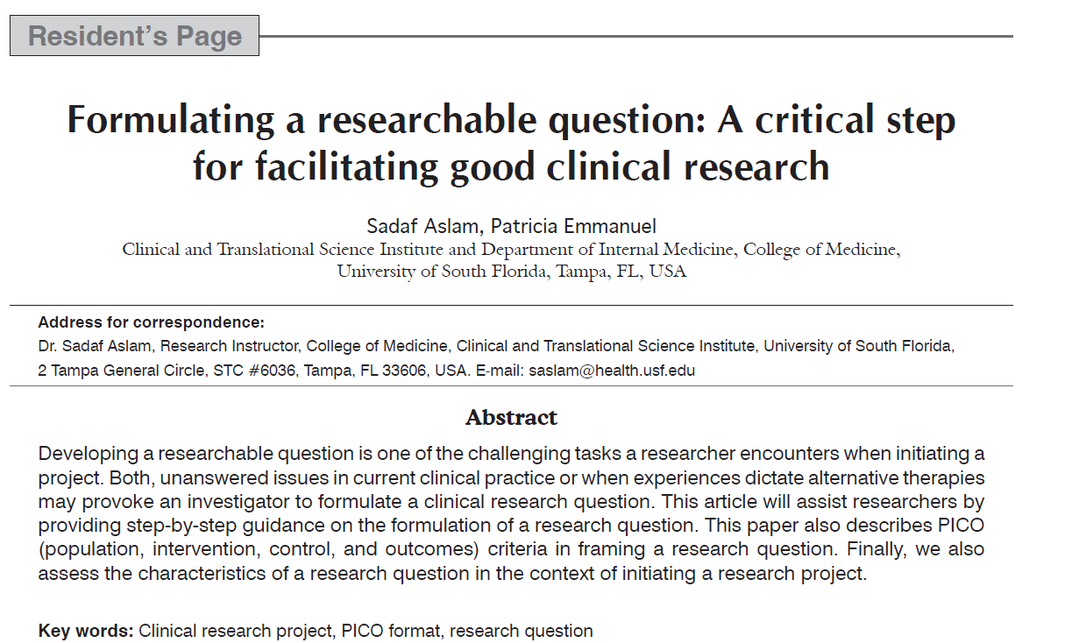

Slide 3
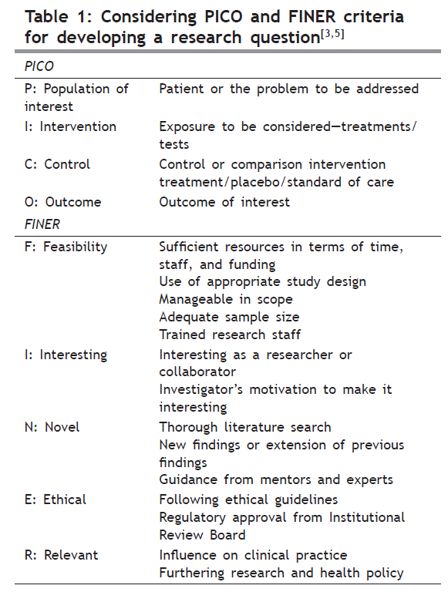

Slide 4
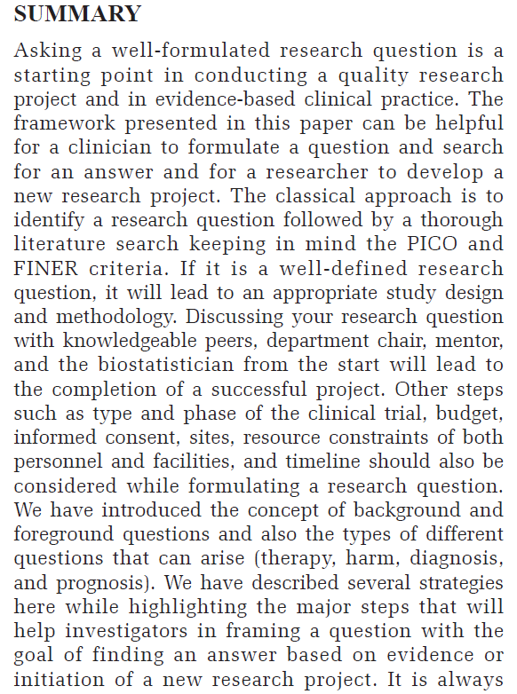

Slide 5
