Slide 1
Introduction to Teaching and Facilitation
Modibo SANGARE, MD, PhD
Cohort 2 Manuscript Writing
AFREhealth Small Award/Hôpital du Mali
August 19,2023

Slide 2
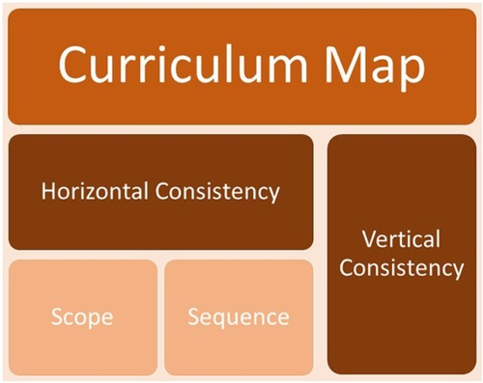
https://o.quizlet.com/Lb1BTskUNIK9NvmopsAm2w.jpg

Slide 3
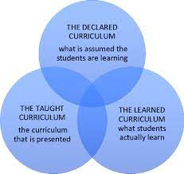
https://encrypted-tbn0.gstatic.com/images?q=tbn:ANd9GcRYfYofx4m92HU43bRcMXN_CVZDlmcUg6zDttQmSQZ_A3y4INxD3icVs9Vx9Wm3WdVQF3Q&usqp=CAU

Slide 4
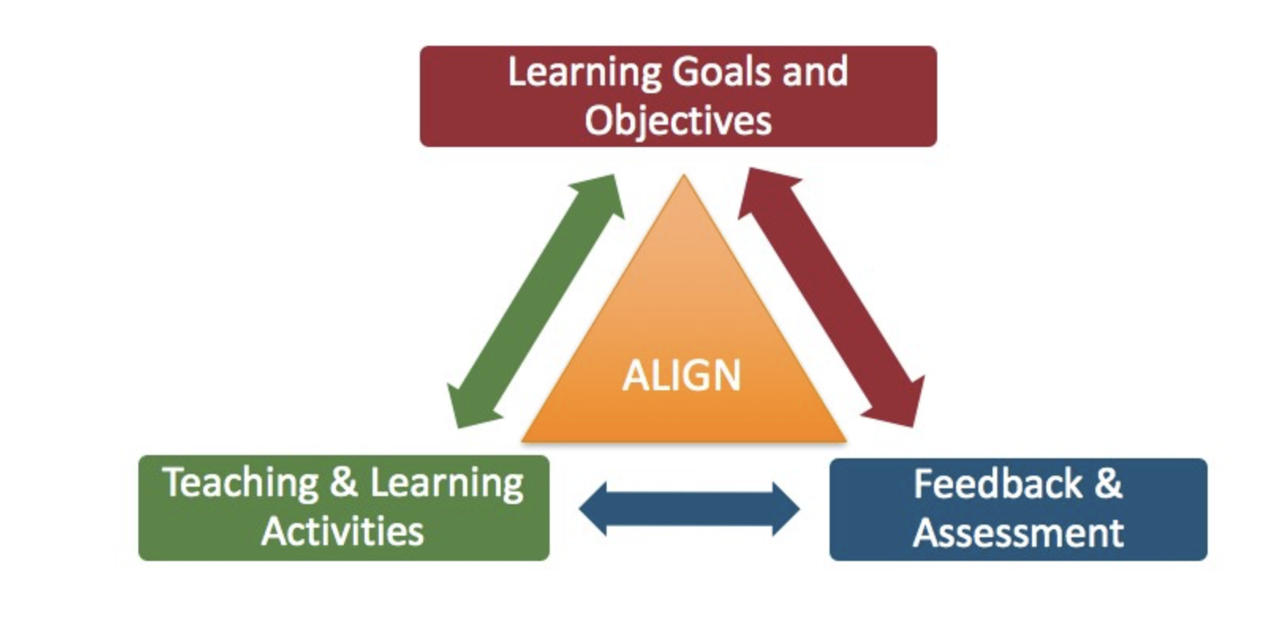
https://educationaltechnology.net/wp-content/uploads/2020/11/instructional-alignment.png

Slide 5
Teaching Activities

Slide 6
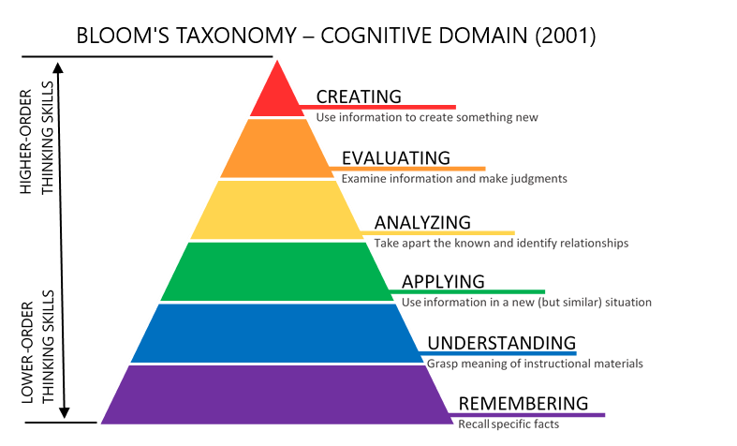
https://citt.ufl.edu/media/cittufledu/images/Blooms-Taxonomy.png

Slide 7
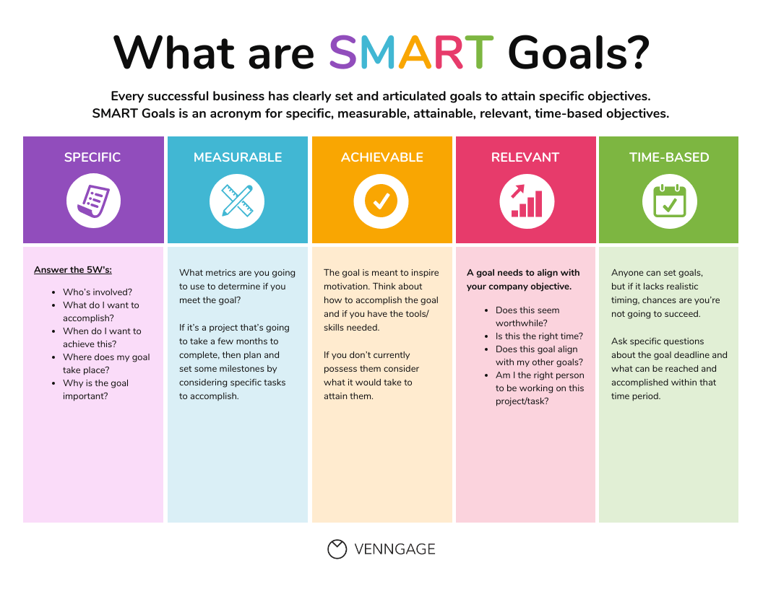
https://venngage-wordpress.s3.amazonaws.com/uploads/2021/08/Learning-Objective-Examples-SMART.png

Slide 8
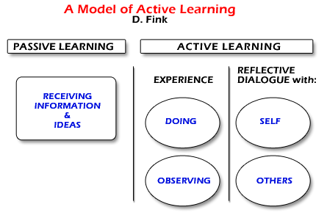
https://sites.google.com/a/boisestate.edu/si2013/self-serve-resources/a-primer-on-course-design/planning-and-developing-learning-activities

Slide 9
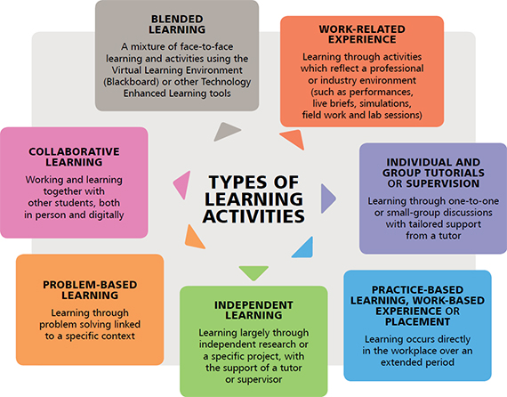
Learning at MSQPS – A Dynamic Educational Approach
https://msqps.edu.om/-Learning

Slide 10
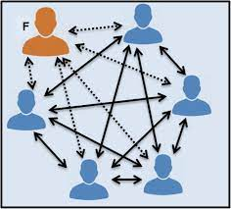
Small Group Facilitation

Slide 11
https://www.bienenseigner.com/wp-content/uploads/2021/04/Evaluation-formative-vs-sommative.jpg

Slide 13
https://qph.cf2.quoracdn.net/main-qimg-f9ce96c214f55b4c3c5c94080206f0b2

Slide 14
https://symondsresearch.com/wp-content/uploads/2021/08/effective-vs-ineffective-feedback.jpg

Slide 15
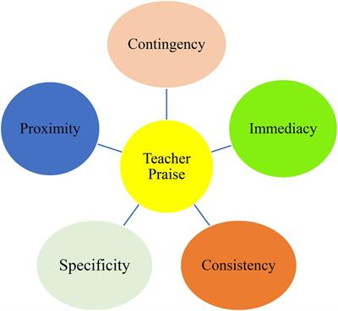
https://www.google.com/url?sa=i&url=https%3A%2F%2Fwww.frontiersin.org%2Farticles%2F10.3389%2Ffpsyg.2021.800798&psig=AOvVaw3NEaxQiPHTwIpNHxkJkzB5&ust=1692526307466000&source=images&cd=vfe&opi=89978449&ved=0CA4QjRxqFwoTCLDs6e-_6IADFQAAAAAdAAAAABAI

Slide 16
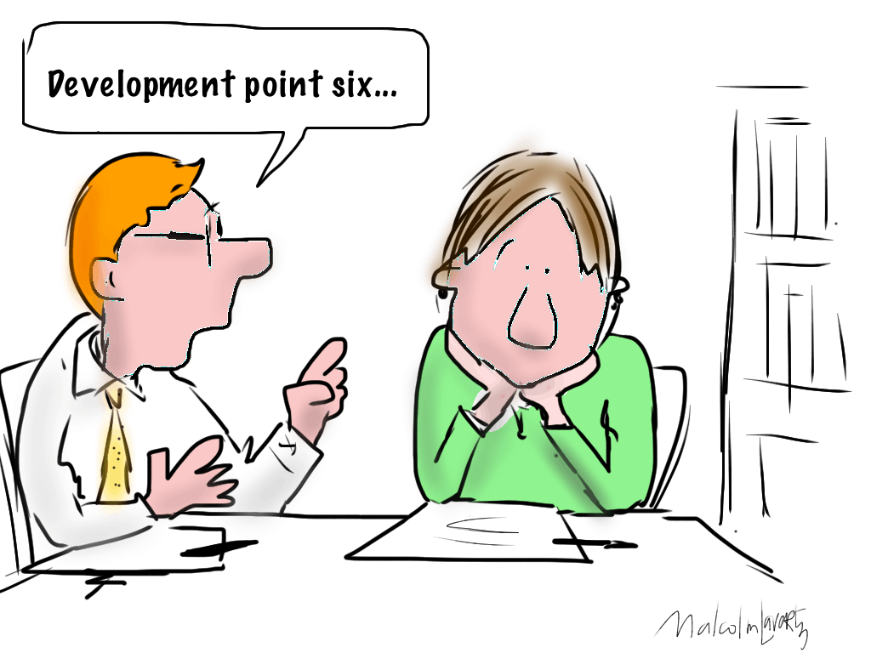
https://www.teachertoolkit.co.uk/wp-content/uploads/2013/09/feedback-1.png

Slide 18
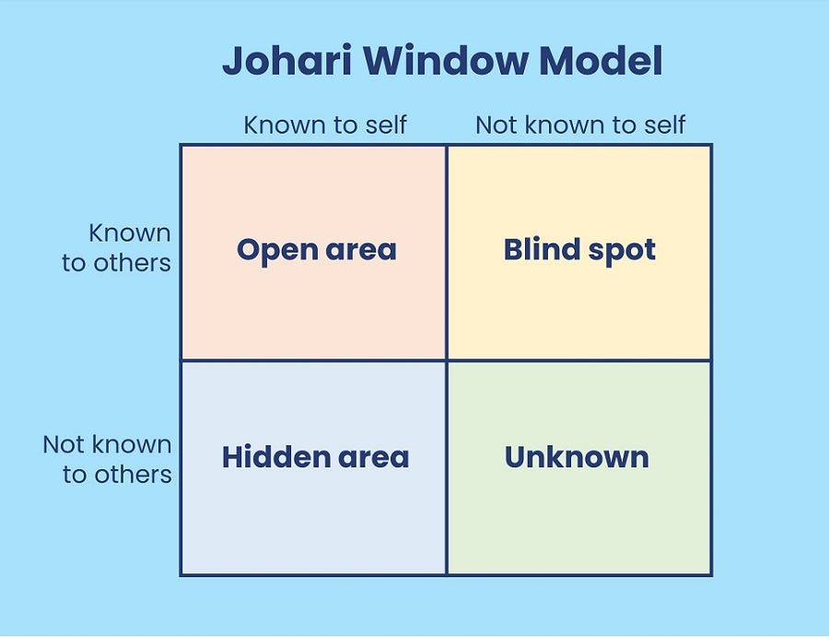
https://miro.medium.com/v2/resize:fit:900/0*MvWPIZtfdGSDfFUh.jpg

Slide 19
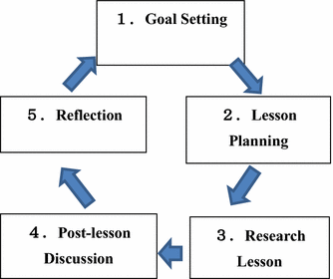
Teaching or Facilitation is a cycle.

Slide 20
Thank you

